Slide 1
Do Bitcoin Futures exhibit safe-haven attributes?
An analysis on the relationship between bitcoin futures and us volatility
Notes:
Aadfadsfasdf

Slide 2
Table of Contents
Introduction to Bitcoin
Similar Literature to Topic
Data Review
Analysis

Slide 3
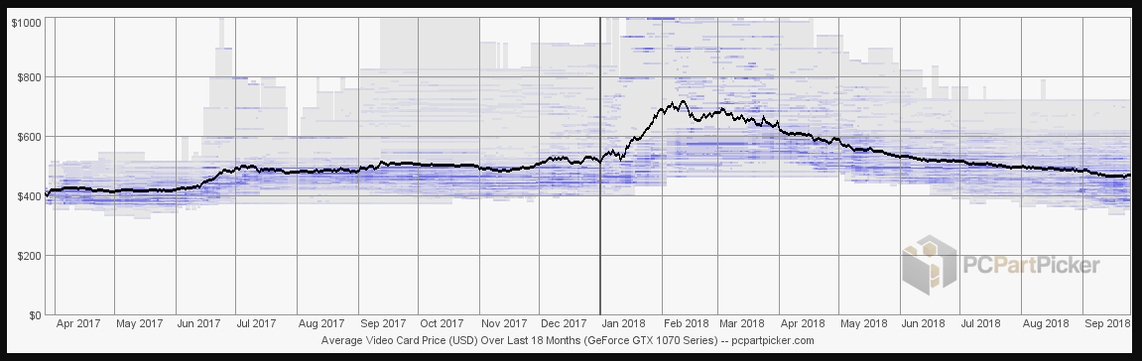
Should Bitcoin be an isolated incident
Journalists believe that the rise in Bitcoin prices increased the demand for all graphics cards

Slide 4
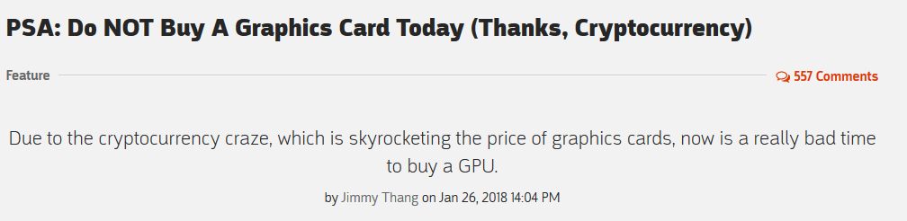
Should Bitcoin be an isolated incident
Journalists believe that the rise in Bitcoin prices increased the demand for all graphics cards

Slide 5
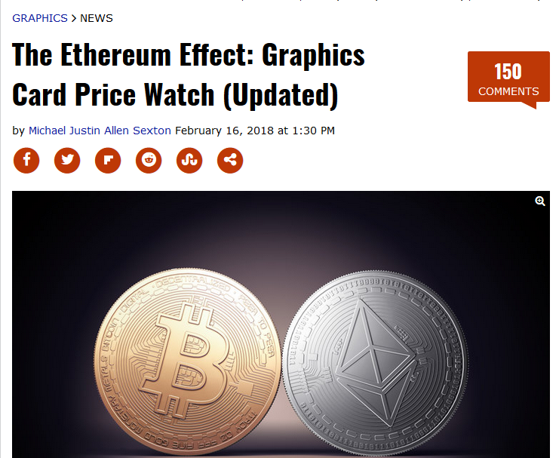
Should Bitcoin be an isolated incident
Journalists believe that the rise in Bitcoin prices increased the demand for all graphics cards

Slide 6
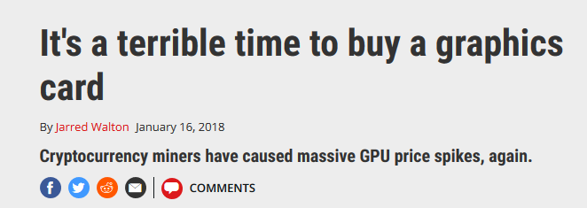
Should Bitcoin be an isolated incident
Journalists believe that the rise in Bitcoin prices increased the demand for all graphics cards

Slide 7
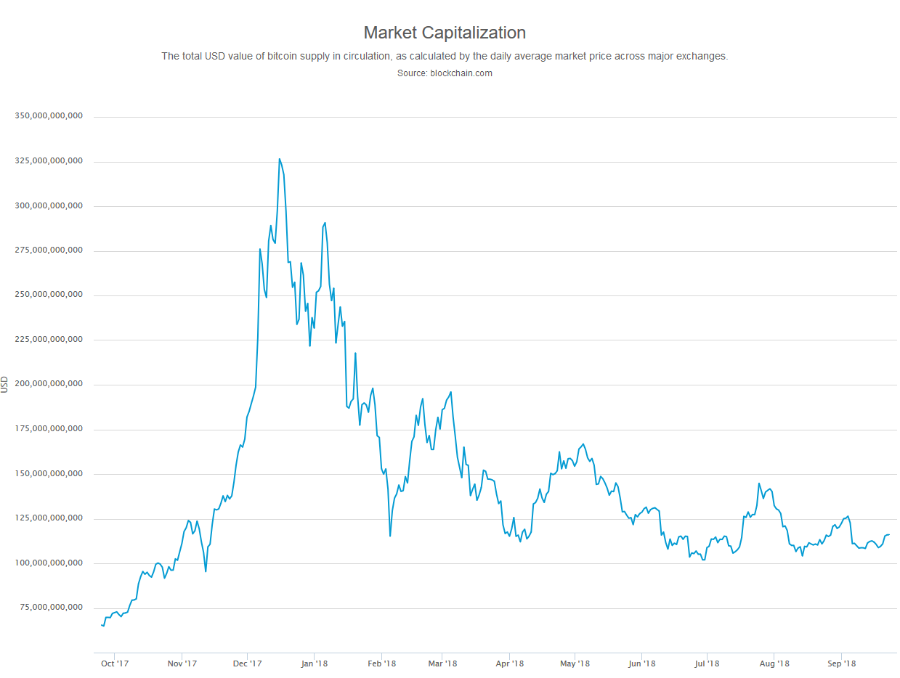
325 Billion USD

Slide 8
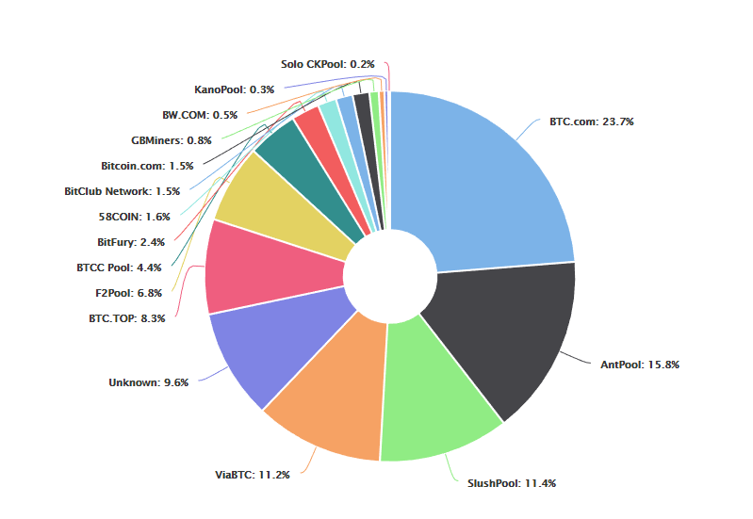
Introduction to Bitcoin
Based on the Block Chain Technology
Decentralized cryptocurrency
Procured through bitcoin exchanges
Miners receive reward ~200k
Bitcoin creation modeled like a precious metal; the number of “mined” bitcoin decreases until 21 million bitcoins are created

Slide 9
Intro to Bitcoin – Currency evaluation & Risks
Is Bitcoin a real currency? An economic appraisal (Yermack 2013 )
Conjectures Bitcoin is more like a speculative investment than a currency
May serve as unit of exchange: More vendors accepting Bitcoin (however small volume) but relatively illiquid
Not a unit of account: wild fluctuations in price
Not a store of value: Rampant Hacking of wallets and exchanges; no financial institutions to protect consumers
*Cannot hedge or short bitcoin
Beware the Middleman: Empirical Analysis of Bitcoin-Exchange (Moore 2013)
Recognizes sizeable counterparty risk: 1/8th of exchanges after shutting down did not reimburse market participants
Notes:
Yermack 2013 argues that

Slide 10

Intro to Bitcoin – Underlying intrinsic value
Sex, Drugs, & Bitcoin: How Much Illegal Activity is Financed Through Cryptocurrencies (Foley, Karlsen, & Putniii 2018)
44% of Bitcoin transactions are for illicit activities
51% of bitcoin holders are identified as illegal users
Illicit activity inversely related to the word “Bitcoin” searches
Notes:
“Use network clustering analysis to identify communities of users based on transactions between users.” Also use Detection controlled estimation through known darknet website owners like the silk road owner

Slide 11
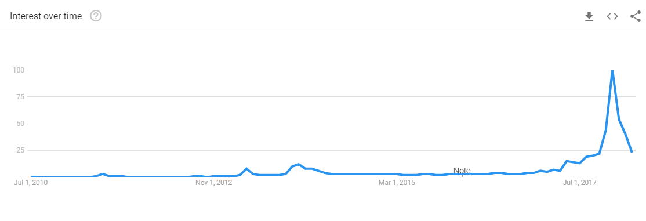
Intro to Bitcoin – Speculative Asset
Bitcoin meets Google Trends and Wikipedia: Quantifying the Relationship between phenomena of the Internet era (Kristoufek 2013)
All Bitcoin users are speculative investors: Expected future payoffs & sentiment drive price
Bi-directional causality for Google searches and Bitcoin Prices
When sentiment is high searches increase price and vise versa
Google Searches of “Bitcoin”
Notes:
Argues bitcoin has no intrinsic value and that bitcoin users are primarily speculative investors; Uses a var model to estimate impact of google searches on

Slide 12
CBOE Bitcoin Futures – An Alternative
Commodity Futures Trading Commission classifies Bitcoin as a commodity in September 2015
Bitcoin futures have attractive features to investors
Settle in cash
Have a unified reference Bitcoin price
Are regulated and protected
Ability to short
Notes:
Somethingasdfasdf asdfsdf

Slide 13
Lit Review
Is Gold a Hedge or a Safe-Haven? An Analysis of Stocks, Bonds, and Gold – (Baur & Lucey 2009)
Plainly defines a Hedge, Diversifier, and Safe-Haven
Hedge – Asset uncorrelated or negatively correlated with another asset
Diversifier – Asset positively correlated but not perfectly
Safe-Haven – A Hedge in times of market turmoil
Finds that gold can act as a Safe-Haven for equities but only 15 days after a market downswing
Notes:
Uses quantiles on quantiles ~ similar to quantile regression. Used to break out the total relationship of bitcoin volatility to gold and global vix. The positive relationship is also shown to hold at higher quantiles of the dependent and independent variables, again primarily for shorter frequency movements of Bitcoin returns. Thus, clearly, the ability of Bitcoin to act as a hedge against uncertainty is conditional on not only whether the market is in bear or bull regime but also whether global uncertainty is high or low.
Specifically speaking, at shorter investment horizons, Bitcoin returns seem to hedge against the global uncertainty at extreme ends of both Bitcoin returns and uncertainty.5

Slide 14
Lit Review
Does Bitcoin hedge global uncertainty (Bouri, Gupta, Tiwari, & Roubaud 2017)
Estimates linear regression between Bitcoin returns and a global volatility index: show its negatively related to Bitcoin in aggregate
Model Quantiles in Quantiles regression essentially breaking out the effect across different ranges of the data: Not related in some cases
Under normal market conditions and in the short term, Bitcoin can act as a hedge
Notes:
Uses quantiles on quantiles ~ similar to quantile regression. Used to break out the total relationship of bitcoin volatility to gold and global vix. The positive relationship is also shown to hold at higher quantiles of the dependent and independent variables, again primarily for shorter frequency movements of Bitcoin returns. Thus, clearly, the ability of Bitcoin to act as a hedge against uncertainty is conditional on not only whether the market is in bear or bull regime but also whether global uncertainty is high or low.
Specifically speaking, at shorter investment horizons, Bitcoin returns seem to hedge against the global uncertainty at extreme ends of both Bitcoin returns and uncertainty.5

Slide 15
Lit Review
On the Return-Volatility Relationship in the Bitcoin Market around the price crash of 2013 (Bouri, & Azzi 2016)
Estimate the asymmetry in Bitcoin return-volatility between negative and positive shocks: when volatility increases prices increase attributed to “Safe-haven effect”
Show a negative relationship between US VIX &Bitcoin volatility but changes after 2013
Added Bitcoin into a portfolio, find that bitcoin reduces risk
Notes:
They use an asymmetric GARCH model that measures one, the volatility in bitcoin prices and two, how the volatility changes with the direction of shocks to the series. Estimation for this model relies on the maximum likelihood method. After finding that there is no statistical evidence that either direction of shocks has a larger magnitude over the other, they break the series into two pieces: before and after the price shock of 2013. When gold prices increase during downward market movements, investors interpret this as an increase in the uncertainty of the macroeconomic environment and thus transmit the increased uncertainty and volatility of the stock market to the gold market. By contrast, if gold prices decrease in periods of rising stock markets, the uncertainty/volatility will similarly be transmitted by investors to the gold market. With the acceptance of Bitcoin as a commodity by the CFTC, any evidence of a positive returnvolatility relation in the Bitcoin market may point toward a safe-haven property. Such evidence can be used to extend the usefulness of Bitcoin as a hedge against equity market turbulence (Dyhrberg, 2015b). With the acceptance of Bitcoin as a commodity by the CFTC, any evidence of a positive return volatility relation in the Bitcoin market may point toward a safe-haven property.

Slide 16
Lit Review
Good News, Bad News and GARCH in Stock Return Data – Craig A. Depken II (2001)
Investigates asymmetry in volatility through decomposing volume data into good and bad news indicators for ten stock split stocks
Finds for younger stocks, the variance reacts asymmetrically to good news

Slide 17
Prior Research Data
Daily data from December 12th 2017 to March 29th 2018

Slide 18
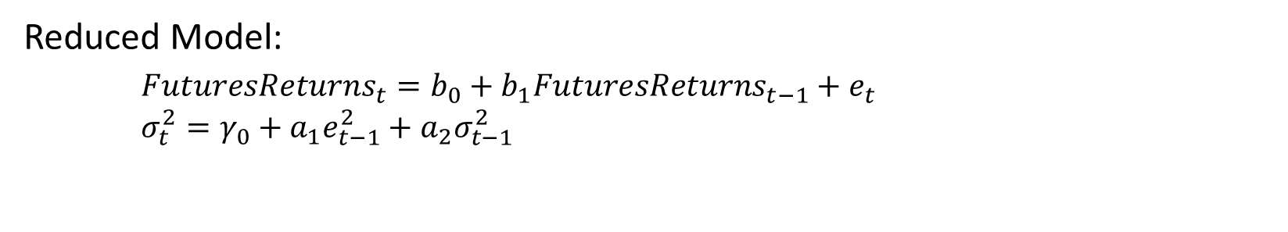
Prior Simple GARCH(1,1) Estimation
Reduced Model:
$FuturesReturns_{t}=b_{0}+b_{1}FuturesReturns_{t−1}+e_{t}$
$σ_{t}^{2}=γ_{0}+a_{1}e_{t−1}^{2}+a_{2}σ_{t−1}^{2}$

Slide 19

Prior Augmented Garch Model
Conditional Variance Estimation:
$FuturesReturns=b_{0}+b_{1}\left(FuturesReturns_{t−1}\right)+e_{t}$
$σ_{t}^{2}=γ_{0}+a_{1}e_{t−1}^{2}+a_{2}σ_{t−1}^{2}+a_{3}(VIX)$
Notes:
Same as study

Slide 20
Prior Volatility Correlation
Futures Garch(1,1) Conditional Variance
VIX Index
Correlation between Bitcoin Futures conditional volatility and VIX is -0.55

Slide 21
Updated Data
Daily data from December 12th 2017 to September 23rd 2018

Slide 22
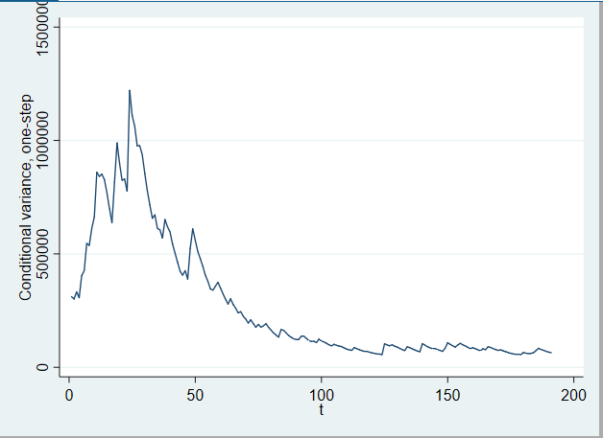
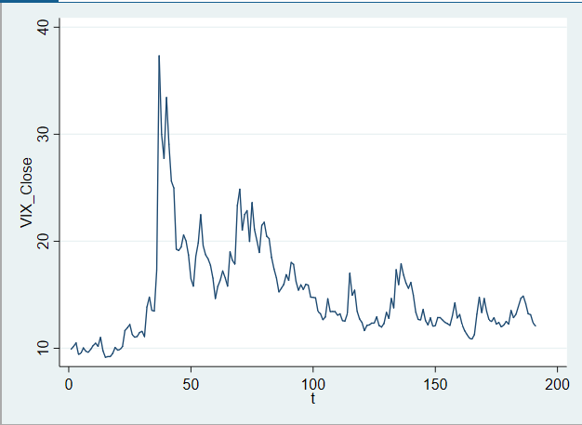
Updated Volatility Correlation
Futures Garch(1,1) Conditional Variance
VIX Index
Correlation between Bitcoin Futures conditional volatility and VIX is -0.02 with wider range of data

Slide 23


Updated Augmented Garch Model
Conditional Variance Estimation:
$FuturesReturns=b_{0}+b_{1}\left(FuturesReturns_{t−1}\right)+e_{t}$
$σ_{t}^{2}=γ_{0}+a_{1}e_{t−1}^{2}+a_{2}σ_{t−1}^{2}+a_{3}(VIX)$
Conditional Variance Estimation:
$FuturesReturns=b_{0}+b_{1}\left(FuturesReturns_{t−1}\right)+e_{t}$
$σ_{t}^{2}=γ_{0}+a_{1}e_{t−1}^{2}+a_{2}σ_{t−1}^{2}+a_{3}(S\&P 500 Volume)$
Positive
Notes:
Same as study

Slide 24

Bad News in S&P 500 Model
Conditional Variance Estimation:
$FuturesReturns=b_{0}+b_{1}\left(FuturesReturns_{t−1}\right)+e_{t}$
$σ_{t}^{2}=γ_{0}+a_{1}e_{t−1}^{2}+a_{2}σ_{t−1}^{2}+a_{3}(Bad News_{t})$
Bad news impacts irrelevant from Good news impacts
Notes:
Same as study

Slide 25
Future Avenues
Evaluation of garch models and specification of conditional variance equation
Further compare times of turmoil in the Bitcoin Market to normal market conditions

